Slide 1
AI/ML Basics

Slide 2
What is Machine Learning ?
Machine learning is the art of study of algorithms that learn from examples and experiences.
Machine learning is based on the idea that there exist some patterns in the data that were identified and used for future predictions.
A computer program is said to learn from experience E with respect to some task T and some performance measure P, if its performance on T, as measured by P, improves with experience E.
Tom Mitchell, 1997

Slide 3
Why Machine Learning ?
Develop systems that can automatically adapt and customize themselves to individual users. — personalized news or mail filters.
Discover new knowledge from large databases (data mining). — Market basket analysis (e.g. beers

Slide 4
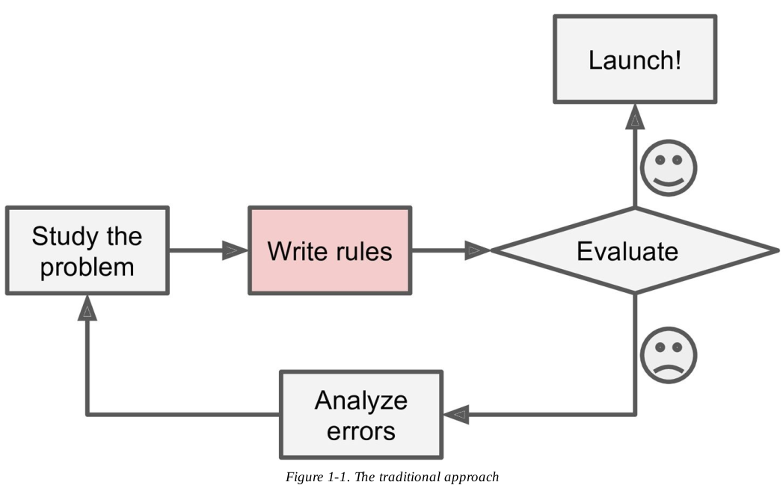
Traditional Approach

Slide 5
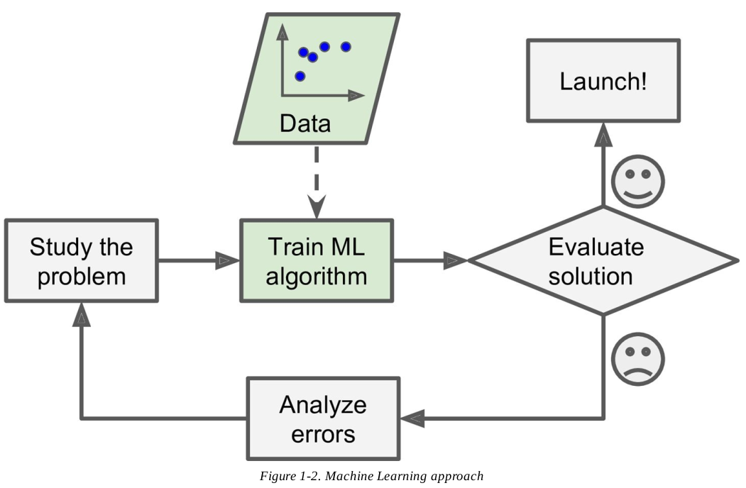
AI/ML Approach

Slide 6
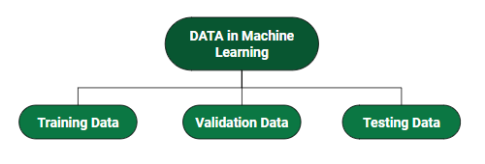
Data is Important
DATA: It can be any unprocessed fact, value, text, sound, or picture that is not being interpreted and analyzed. Data is the most important part of all Data Analytics, Machine Learning, Artificial Intelligence. Without data, we can’t train any model and all modern research and automation will go in vain. Big Enterprises are spending lots of money just to gather as much certain data as possible.

Slide 7
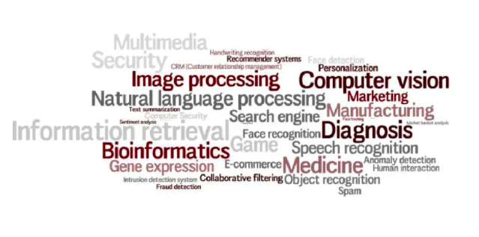
AI/ML Applications

Slide 8
Categories
Supervised learning
Unsupervised learning
Reinforcement learning

Slide 9
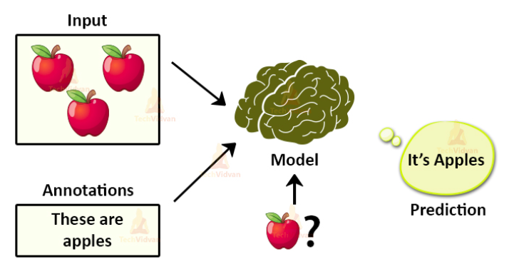
Supervised Learning

Slide 10
What is supervised learning?
Supervised learning is an approach to creating artificial intelligence (AI), where a computer algorithm is trained on input data that has been labeled for a particular output. The model is trained until it can detect the underlying patterns and relationships between the input data and the output labels, enabling it to yield accurate labeling results when presented with never-before-seen data.
Supervised learning is when the model is getting trained on a labelled dataset. A labelled dataset is one that has both input and output variables. In this type of learning both training and validation, datasets are labelled as shown in the figures above.

Slide 11
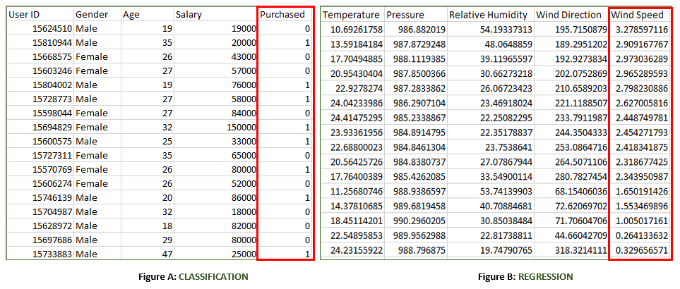

Slide 12
Regression Algorithm | Classification Algorithm
In Regression, the output variable must be of continuous nature or real value. | In Classification, the output variable must be a discrete value.
The task of the regression algorithm is to map the input value (x) with the continuous output variable(y). | The task of the classification algorithm is to map the input value(x) with the discrete output variable(y).
Regression Algorithms are used with continuous data. | Classification Algorithms are used with discrete data.
In Regression, we try to find the best fit line, which can predict the output more accurately. | In Classification, we try to find the decision boundary, which can divide the dataset into different classes.
Regression algorithms can be used to solve the regression problems such as Weather Prediction, House price prediction, etc. | Classification Algorithms can be used to solve classification problems such as Identification of spam emails, Speech Recognition, Identification of cancer cells, etc.
The regression Algorithm can be further divided into Linear and Non-linear Regression. | The Classification algorithms can be divided into Binary Classifier and Multi-class Classifier.

Slide 13
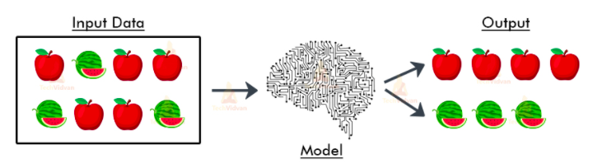
Unsupervised Learning

Slide 14
What is Unsupervised Learning?
As the name suggests, unsupervised learning is a machine learning technique in which models are not supervised using training dataset. Instead, models itself find the hidden patterns and insights from the given data. It can be compared to learning which takes place in the human brain while learning new things. It can be defined as:
Unsupervised learning is a type of machine learning in which models are trained using unlabeled dataset and are allowed to act on that data without any supervision.

Slide 15
Example: Finding customer segments
Clustering is an unsupervised technique where the goal is to find natural groups or clusters in a feature space and interpret the input data. There are many different clustering algorithms. One common approach is to divide the data points in a way that each data point falls into a group that is similar to other data points in the same group based on a predefined similarity or distance metric in the feature space.
Clustering is commonly used for determining customer segments in marketing data. Being able to determine different segments of customers helps marketing teams approach these customer segments in unique ways. (Think of features like gender, location, age, education, income bracket, and so on.)

Slide 16
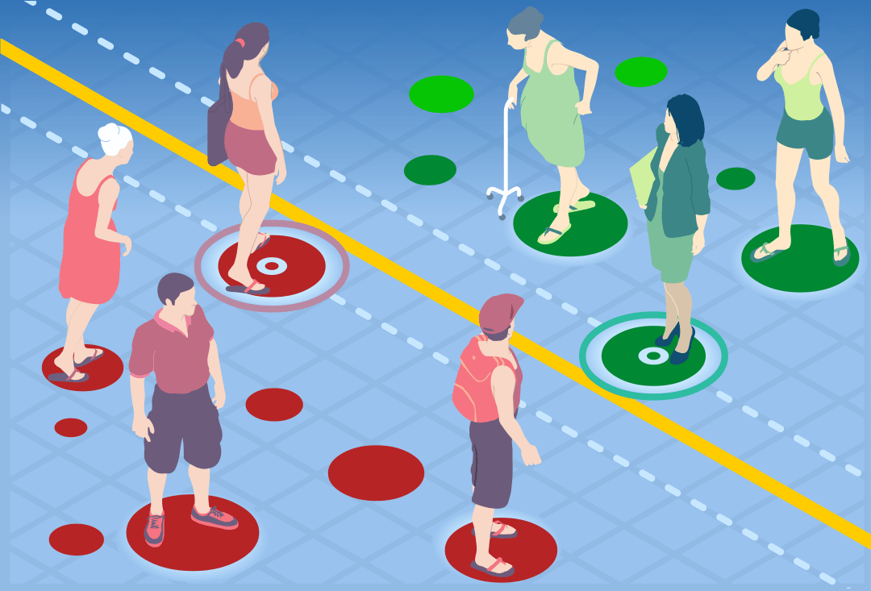

Slide 17
What is Reinforcement Learning?
Reinforcement Learning is a feedback-based Machine learning technique in which an agent learns to behave in an environment by performing the actions and seeing the results of actions. For each good action, the agent gets positive feedback, and for each bad action, the agent gets negative feedback or penalty.
Reinforcement learning is all about making decisions sequentially. In simple words, we can say that the output depends on the state of the current input and the next input depends on the output of the previous input

Slide 18
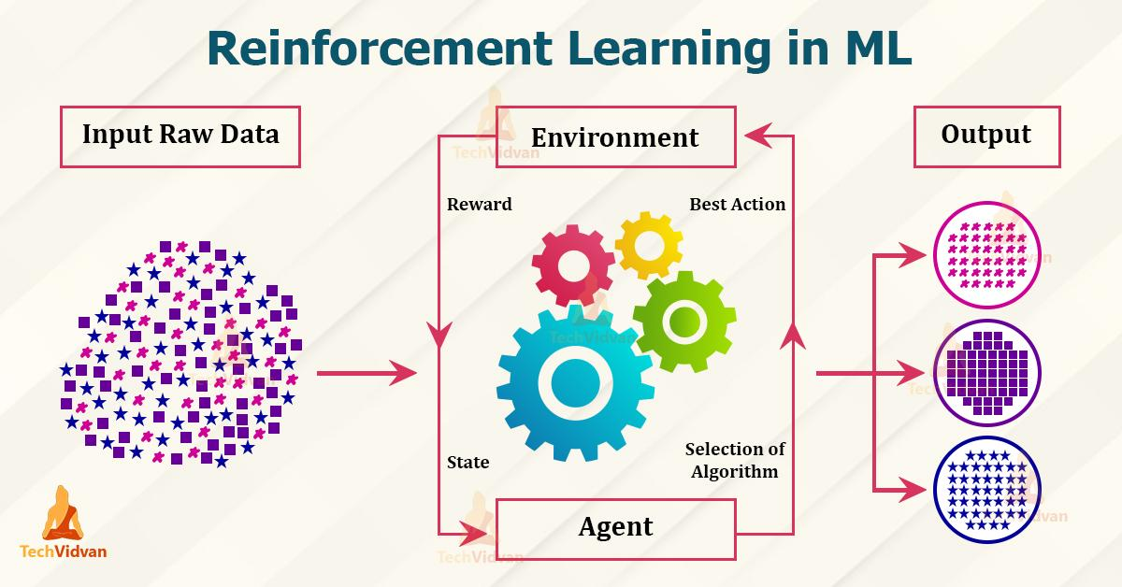

Slide 19
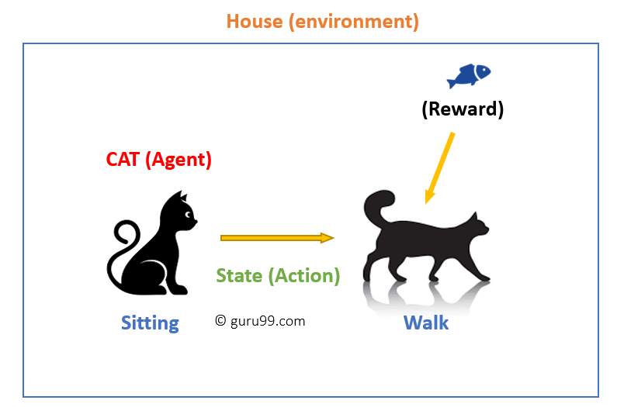

Slide 20
https://github.com/saininaresh4435/Basic-AI-ML-Session

Slide 21
Any Questions ?

Slide 22
Thank You

